Slide 1
Harnice!
Your free, open-source electrical system CAD tool.

Slide 2
BACKGROUND

Slide 3
Define “Electrical System”
Battery
An electrical system is any collection of circuit boards, electrical boxes, devices, etc, that connect to and interact with each other with wires or harnesses
Examples:
Concert sound system
Control compute system for plane, car, rocket
Commercial power distribution system
iPhone
City power distribution network
Vehicle computer
Power distribution unit
Needs Graphics Online
Network switch
Actuator controller
Sensor DAC unit
Actuator
Pressure sensor
Pressure sensor
Pressure sensor

Slide 4
What problem is Harnice trying to solve?
There should always be one single source of truth that describes the devices in your system and how they are connected. Harnice helps designers keep track of it.
Harnice provides a landing pad for designers to be able to define design rules that can build, validate, simulate, or perform any other action on their system design in a clear, concise, human-readable, and machine-readable format.
Harnice helps designers produce any possible downstream data that can be derived from the system definition. Any system artifact will always be directly traceable back to the original source of truth.
Added to mkdocs

Slide 5
Where does the Harnice scope end? *at this point*
We’re not yet concerned about what’s going on inside your devices
Only how they interact with the outside world
Software configuration
Sure, you can write any rule you want into your Harnice system processor, but Harnice is intended to track hardware.
How your electrical hardware interacts with non-electrical things
Don’t care about size, weight, fluid type, mounting, physical, thermal, environmental compliance, etc.
As-built configurations
We aren’t yet offering complete ERP/MES functionality
Added to mkdocs

Slide 6
DESIGN METHODOLOGY

Slide 7
How are you designing your system right now?
Existing “Smart” Software Packages
Existing Manual Options
Harnice solves all of this!
Literal paper and pen hand drawings
Vizio, Powerpoint, Excel, MS Paint, WireViz make good-looking drawings but without metadata
Design rule checks impossible
Conflicting sources of truth
Zuken, E-plan, Altium Harnessing, etc
SUPER expensive
Training-intensive
Not user-friendly
Not customizable
Added to mkdocs

Slide 8
Instead, let the machines work for you!
Without Harnice…
Designers compile, read, sort through information either from a design guide, from industry knowledge, or other sources…
…manually…
while documenting the results of their studies, until their design is complete.
Bad because there’s inherently less traceability back to design intent, rampant broken links to sources of truth, results scale proportionally to design time
Instead, with Harnice…
Designers are encouraged to spend their time documenting their design inputs (standards, rules, trades, processes), in a machine-readable format.
So much better because python does the boring work while the designers put their brains to use!
Added to mkdocs

Slide 9
Minimum viable inputs…
Harnice will operate on just the following…
Devices are fully defined
Every signal, channel, connector is accounted for in every device
Sufficient device electrical behavior is defined
A block diagram is drawn by the designer
Each device is accounted for, and each harness connection is made linking connectors
Your rules are qualitatively expressed
Channel mapping preferences
Part selection tree
Length, size, count, device attribute requirements
Any other rule you could possibly ever need
Physical harness routing information can be imported or manually defined
Added to mkdocs

Slide 10
… regard unlimited outputs
Given a system definition, the following can be produced automatically, predictably, effortlessly:
Bill of materials of your entire system
(devices, harnesses, parts, cable lengths, bits of heat shrink, volume of solder, you name it)
Versions, release dependencies, part number per reference designator, etc
Every harness build drawing, formboard, wirelist in PDF and CSV formats, all at once
Even stylistic choices can be automated into your system render
Electrical behavior
Steady-state and even transient system responses can be simulated with just simple device and harness lump-element definitions
Write your own!
Harnice makes it easy to write simple Python scripts that can tell you anything about your system.
Added to mkdocs

Slide 11
THE SOLUTION

Slide 12
Workflow Overview
User editable per product
Generated file
When you “render” a product (run harnice –r from the command line or GUI button press), a long process is executed.
During the process, existing information is queried, processed, and every output is regenerated.
Added to mkdocs
device
Device Feature Tree
Device Signals List
Device Kicad Symbol
System Definition (kicad_sch)
System Feature Tree
System Instances List
system
Harness feature tree
Harness Instances List
Harness Build Drawing PDF set
harness

Slide 13
Defined Manually
Defined in Device Feature Tree
Defined in System Feature Tree
Defined in Harness Feature Tree
Device Signals List
Added to mkdocs
Device, channel definitions
System build rules
KiCad symbol
Channel map, disconnect map, circuits list
System Instances List
System harness manifest, post harness instances list
System simulation processor
KiCad block diagram
Netlist
Harness build rules
Harness instances list
Harness drawings

Slide 14
The Approach
Harnice is a python package that processes netlists and turns them into outputs.
Specify your system definition using Kicad or Altium to make a block diagram
Components represent devices
Nets represent harnesses
Harnice runs a bunch of code on your netlist to determine harness requirements
Builds a channel map
Builds a System Instances List (list of every part and every connection for every harness)
Harnice harness editor can look for a harness inside a system
Adds parts based on standard build rules
Exports build drawings and other artifacts instantaneously
Added to mkdocs

Slide 15
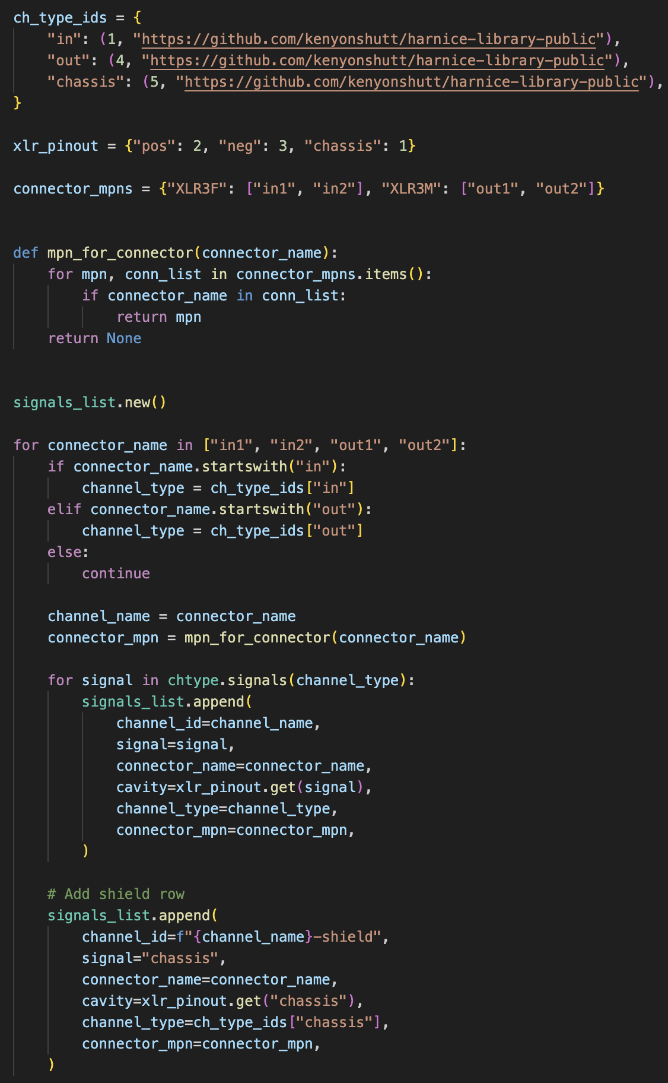
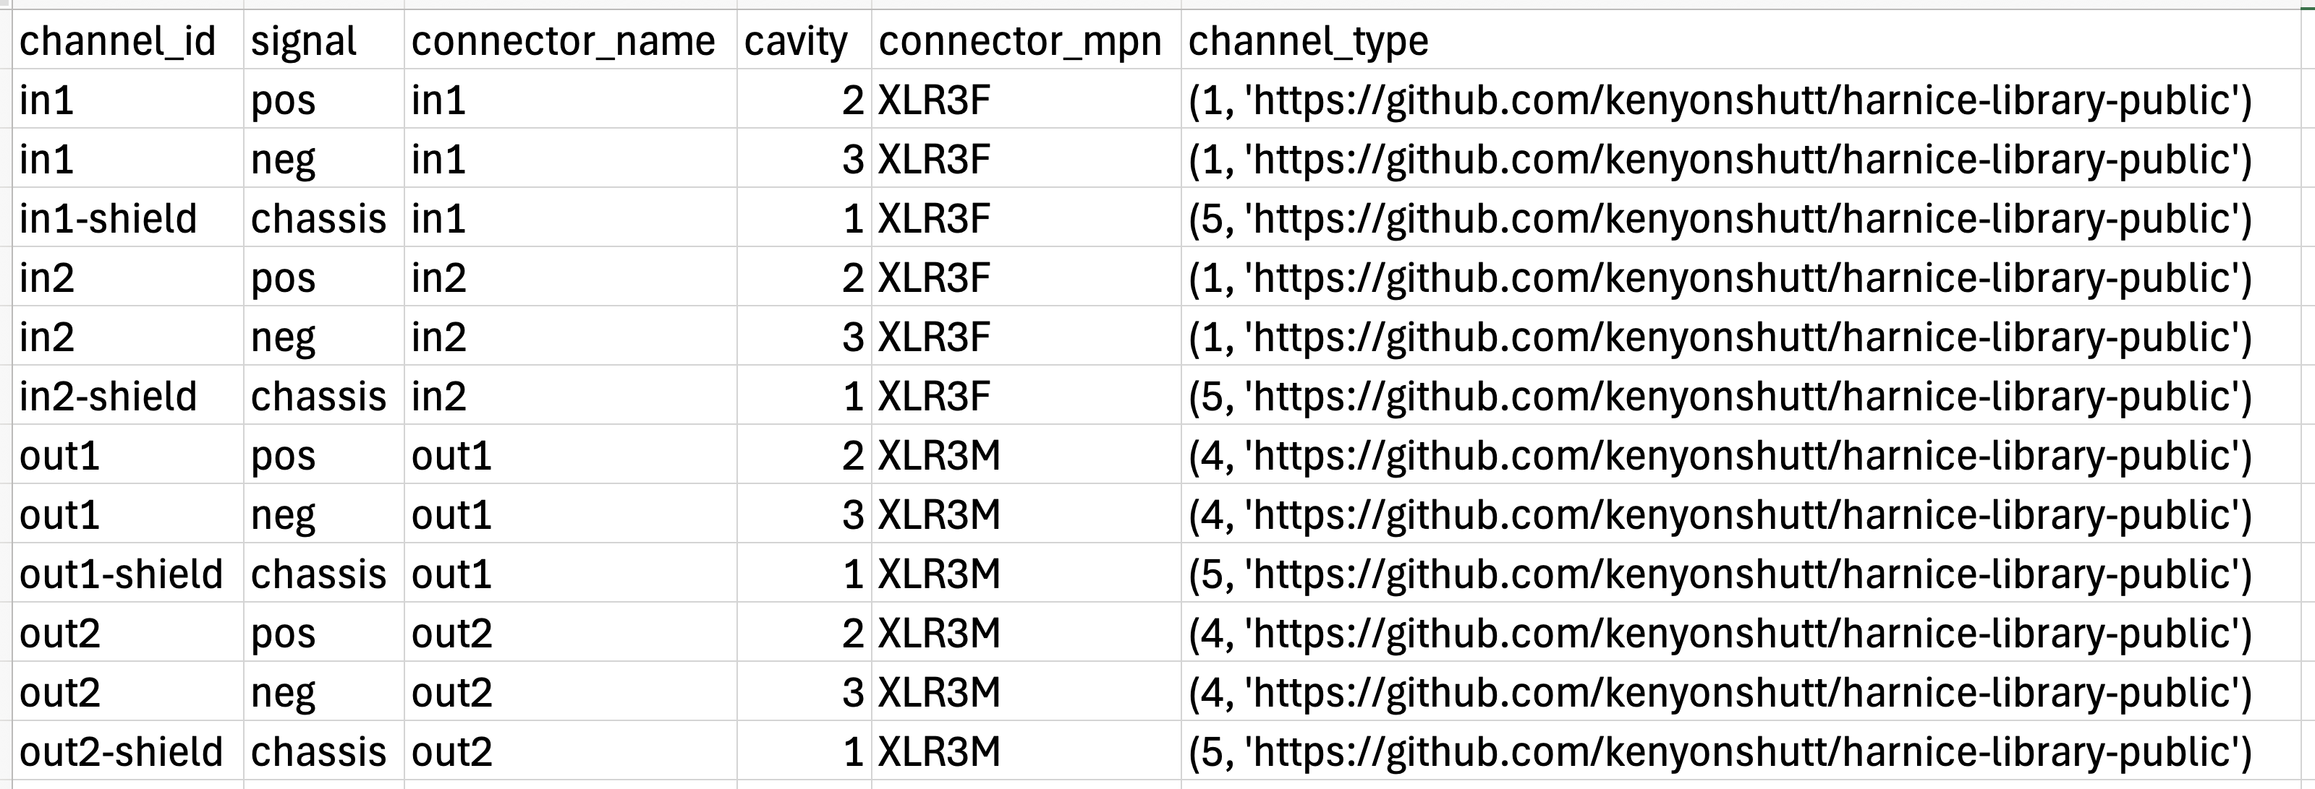
Defining your Devices
Needs Graphics Online
Primary data structure of a device is a TSV called “signals_list”.
Generated from a python script that you define
Produces a KiCad symbol that you can import into your project for a block diagram.
Future work: will contain a .kicad_esch file that will allow you to define device electrical behavior.

Slide 16
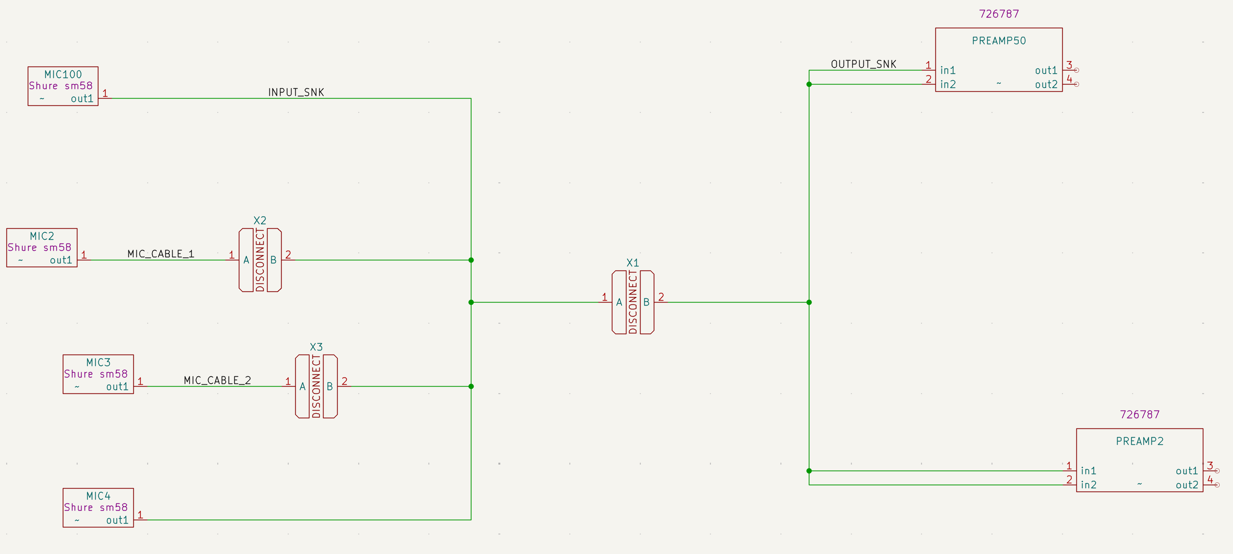
Defining your Block Diagram
Device symbols can be added to your KiCad schematic.
KiCad wires can be drawn that represent entire harnesses.
KiCad is agnostic to the individual conductors, channels, or signals of a harness, just that there are certain connectors that are connected to each other.
Needs Graphics Online

Slide 17
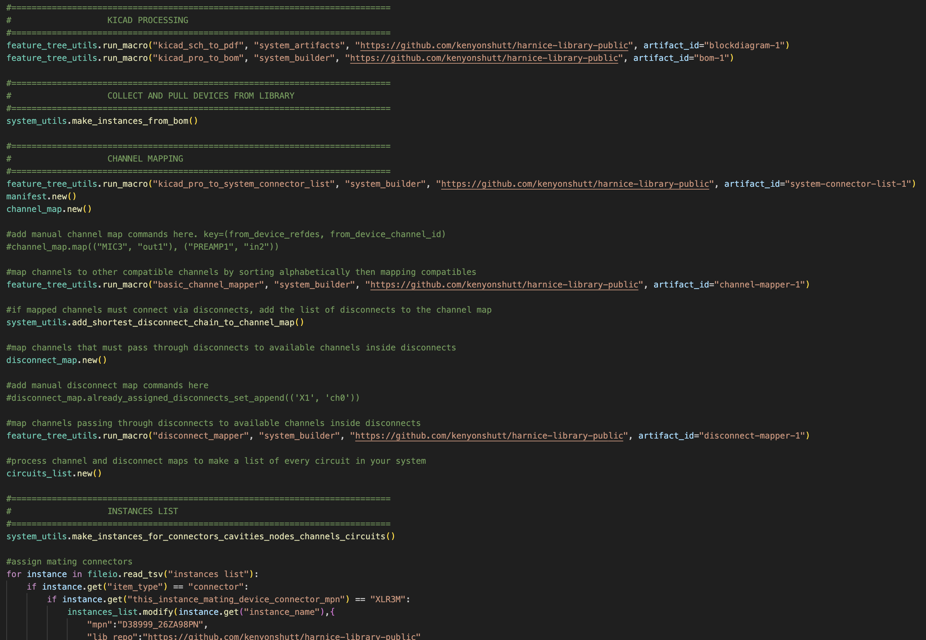
Rendering your System
When a python file (feature_tree.py) is called, the KiCad netlist is exported, channels are mapped, and a system instances list is generated.
Each system has its own feature tree, and it acts as the primary collector for your design rules.
Added to mkdocs

Slide 18
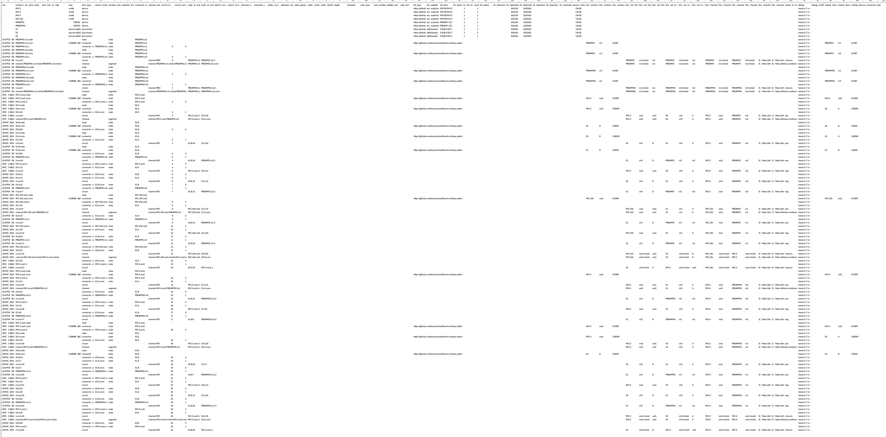
System Instances List
An instances list is the complete source of truth for a system.
It’s a TSV database that records every possible item and its attributes that may belong to your system.
This file is where every downstream output pulls data from.
Added to mkdocs

Slide 19
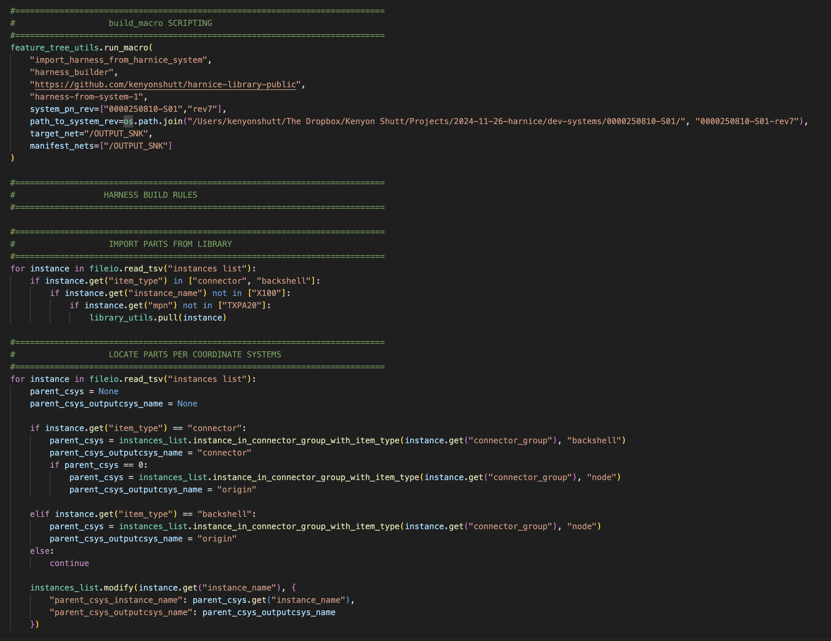
Harness Feature Tree
When a python file (feature_tree.py) is called, a System Instances List is queried, and every instance that’s related to the associated KiCad net is brought in.
Similar to systems, each harness has its own feature tree, and it acts as the primary collector for your design rules.
It is also in charge of producing outputs, like build drawings, formboard drawings, or wirelists. More on those later.
Added to mkdocs

Slide 20
DEFINITION OF TERMS

Slide 21
Harnice’s strict requirement on flexibility
Major departure from existing eCAD packages:
YOU CAN PUT ANYTHING* ANYWHERE.
As long as a thing can be defined as an “instance”, it can end up in your electrical system. Harnice doesn’t care if you need string, nails, plumbing fittings, raccoons, cables, or connectors.
You write your own instance definitions, your own item_types, your own vocabulary, your own relationships.
*The following slides define the exceptions to the above. We couldn’t get away with everything.
Added to mkdocs

Slide 22
General Terminology
NEEDS CONTENT
Sorted alphabetically ->
channel_ map | circuits_list | disconnect _map | instances_list | library_ history | manifest | manual_ flagnotes_list | netlist | post_ harness_ instances_list | rev_ history | signals_ list
A list of channels on devices within merged_nets that are either mapped to other channels or are unmapped | A list of every individual electrical connection that must be present in your system or harness to satisfy your channel and disconnect maps | A list of every available channel on a every disconnect, and every channel that may or may not pass through it | A list of every physical or notional thing, drawing element, or concept that defines a system or harness | A report of what was imported during the most recent render of the current product | A table that relates reference designator to part number(s), and may contain other information indexed to the reference designator | A file where users can manually define flagnotes | SHOULD WE CALL THIS CONNECTORS LIST? | A list of every physical or notional thing, drawing element, or concept that includes instances added at the harness level, that represents a system | A record of every revision of a part, and its release status | A list of circuits that appear on connectors and are part of channels that belong to a device
Added to mkdocs

Slide 23
Types of Products
These are things you can “render” by calling harnice -r or harnice --render from within a partnumber/revision directory, but when done so, fundamentally different things happen.
Sorted alphabetically ->
cable | channel_ type | device | disconnect | flagnote | harness | part | system | tblock
Something you can purchase by the spool or lot, contains conductor(s) that can be assigned to circuits inside a harness. Usually shows up in a bill of materials. | Uniquely identifiable set of signals that allow electrical intent to be documented and later referenced | Item you can buy that has signals, connectors, channels. Exhibits electrical behavior. The fundamental “block” element in a block diagram. | Set of two electrical connectors that has a predefined pinout, connector selection, and set of channels that can host circuits. | A bubble shape on a drawing that usually points to something via a leader arrow. | A set of circuits that satisfies a channel map. Also contains instructions about how to be built from a set of selected parts. | Something you can purchase per each or per unit. May have a 1:1 drawing that can be located on a formboard drawing. usually shows up in a bill of materials. | A collection of devices and harnesses that satisfies a set of functionality requirements for some external purpose. | A page SVG, usually with your name or company logo, that makes your drawings look professional.
Added to mkdocs

Slide 24
Types of Lists
These are commonly used data structures in Harnice. They’re almost all TSV’s (tab-separated values). Functions related to these lists can be called by list_name.command()
Sorted alphabetically ->
channel_ map | circuits_list | disconnect _map | instances_list | library_ history | manifest | manual_ flagnotes_list | netlist | post_ harness_ instances_list | rev_ history | signals_ list
A list of channels on devices within merged_nets that are either mapped to other channels or are unmapped | A list of every individual electrical connection that must be present in your system or harness to satisfy your channel and disconnect maps | A list of every available channel on a every disconnect, and every channel that may or may not pass through it | A list of every physical or notional thing, drawing element, or concept that defines a system or harness | A report of what was imported during the most recent render of the current product | A table that relates reference designator to part number(s), and may contain other information indexed to the reference designator | A file where users can manually define flagnotes | SHOULD WE CALL THIS CONNECTORS LIST? | A list of every physical or notional thing, drawing element, or concept that includes instances added at the harness level, that represents a system | A record of every revision of a part, and its release status | A list of circuits that appear on connectors and are part of channels that belong to a device
Added to mkdocs

Slide 25
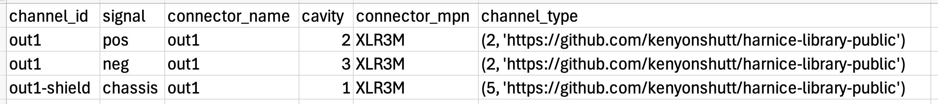
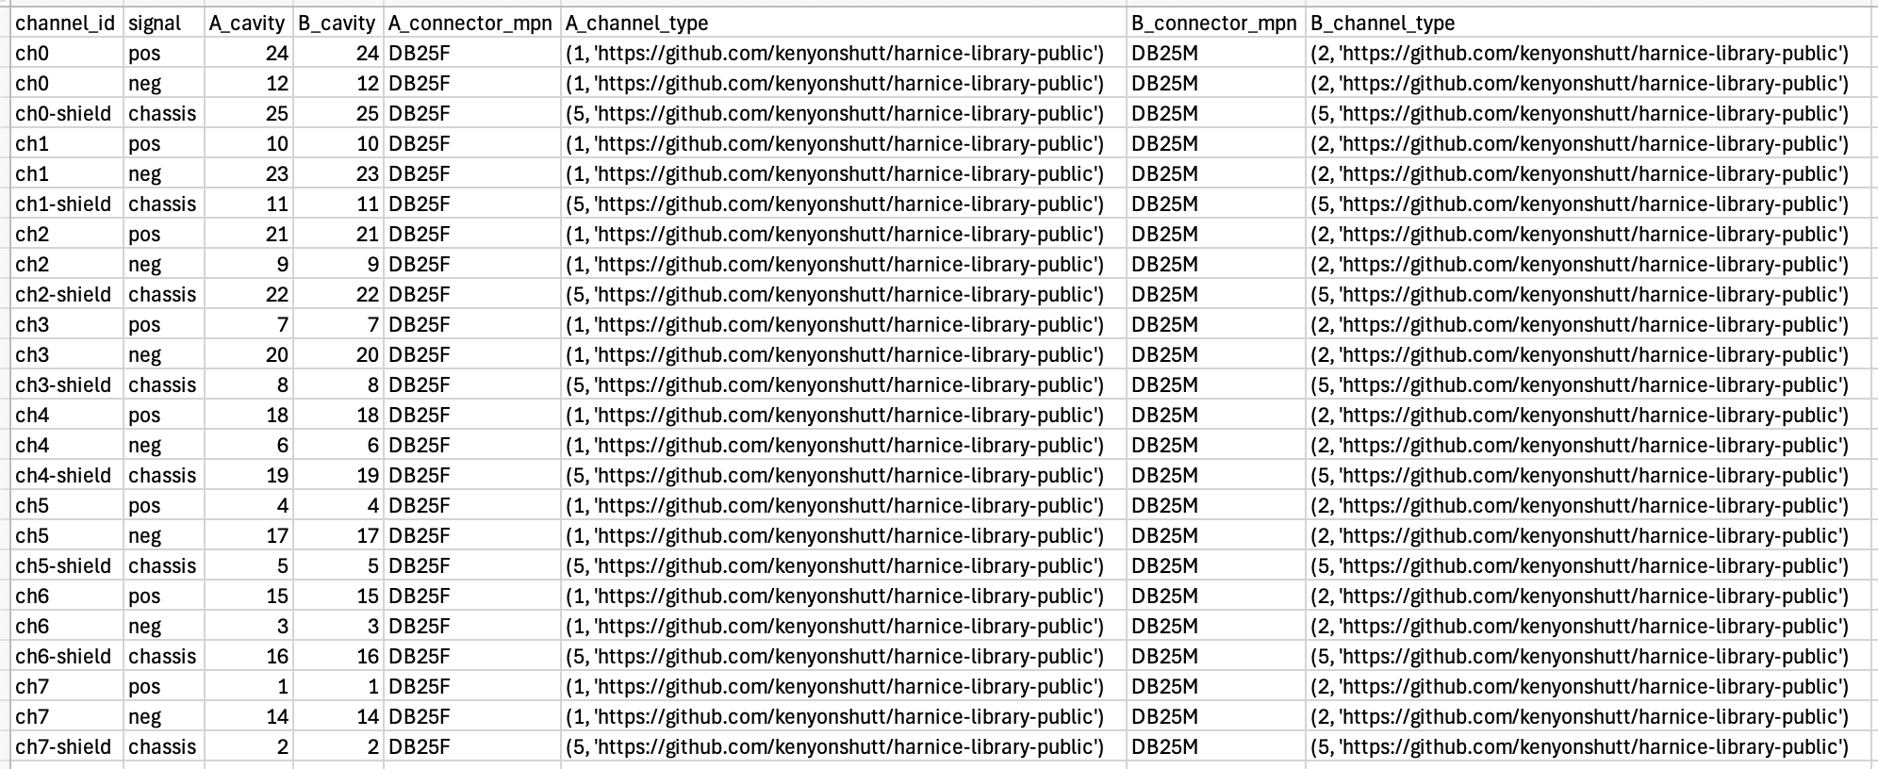
Signals Lists
Device signals list (for Shure SM58 microphone)
Signals Lists are the primary way Harnice stores information about devices
Source of truth for devices or disconnects
Exhaustive list of every electrical connection going into or out of the device or disconnect
Added to mkdocs
Disconnect signals list (for a bespoke audio use case)
channel_ map | circuits_list | disconnect _map | instances_list | library_ history | manifest | manual_ flagnotes_list | netlist | post_ harness_ instances_list | rev_ history | signals_ list

Slide 26
Signals List Feature Tree
You can use a script to easily write long Signals Lists. Rely on basic Python to avoid typing manually.
harnice -r device
Or
harnice -r disconnect
Signals List Exists
no
yes
Needs Graphics Online
Feature Tree Exists
Feature Tree Exists
yes
yes
no
no
Make new feature_tree.py from default
Run feature_tree.py
Validate and exit
channel_ map | circuits_list | disconnect _map | instances_list | library_ history | manifest | manual_ flagnotes_list | netlist | post_ harness_ instances_list | rev_ history | signals_ list

Slide 27
Rules about Signals Lists
Every combination of (channel_id, signal) must be unique within the signals list
You can’t have two “ch1, pos” signals on the same device
Every signal of a channel_type must be present in the Signals List
If your channel_type requires “positive” and “negative”, you have to have both in your signals list
Every signal in the Signals List must be present in the channel_type
If you need to add signals that aren’t already part of your pre-defined channel_type, you’ll need to define a new channel_type.
You can’t put signals of the same channel on different connectors
While this may sound convenient, it breaks a lot of internal assumptions Harnice is making on the back end about how to map channels.
If you need to do this, I recommend defining one channel type per signal, then write a macro for mapping the channels to their respective destinations.
“A” and “B” channels of the same disconnect must be compatible with each other
Added to mkdocs
channel_ map | circuits_list | disconnect _map | instances_list | library_ history | manifest | manual_ flagnotes_list | netlist | post_ harness_ instances_list | rev_ history | signals_ list

Slide 28
Signals List Fields
signals_list.write_signal()
Device signals list
channel_id | signal | connector_name | cavity | connector_mpn | channel_type
Unique name of the channel that this signal is part of | Electrical signal “positive”, “TX”, etc | Name of the connector | Cavity name of where this signal lands on your device | Be specific, this may directly end up in your BOM later | Intended purpose, mate, and map compatibility is contained here
Added to mkdocs
Disconnect signals list
channel_id | signal | A_cavity | B_cavity | A_connector_mpn | A_channel_type | B_connector_mpn | B_channel_type
Unique name of the channel that this signal is part of | Electrical signal “positive”, “TX”, etc | Cavity name of where this signal lands on the “A” side of this disconnector | Usually the same as “A” cavity if the connectors are compatible | Be specific, this may directly end up in your BOM later | Intended purpose, mate, and map compatibility is contained here |  | Not necessarily the same as “A_channel_type” because one side of disconnect is usually “input” and the other is “output”
channel_ map | circuits_list | disconnect _map | instances_list | library_ history | manifest | manual_ flagnotes_list | netlist | post_ harness_ instances_list | rev_ history | signals_ list

Slide 29
KiCad Integration
When you render a device Signals List, it’ll make a KiCad schematic symbol in the parent directory
KiCad Symbol will contain ports that match the set of connectors that you’ve specified in Signals List
Render will not affect placement or graphic design of your symbol, just port count and symbol attributes
Added to mkdocs
channel_ map | circuits_list | disconnect _map | instances_list | library_ history | manifest | manual_ flagnotes_list | netlist | post_ harness_ instances_list | rev_ history | signals_ list

Slide 30
Signals List Lightweight Render
If you need to build a KiCad block diagram quickly, without specifying channels and signals, you can with --lightweight.
Run harnice -l device or harnice --lightweight device from your device directory.
This will follow the same flowchart as --render, but truncate the validation process.
You will not be able to map channels with --lightweight
Added to mkdocs
channel_ map | circuits_list | disconnect _map | instances_list | library_ history | manifest | manual_ flagnotes_list | netlist | post_ harness_ instances_list | rev_ history | signals_ list

Slide 31
Signals List Python Commands
Command | Args | Returns | Purpose
signals_list.new_list() |  |  | Create a new list
signals_list.write_signal() | See earlier slides on what’s required and why |  | Add a signal to a signals list
signals_list.signals_of_channel_type() | Channel type in touple form (channel_type_id, repo) *One arg, in parenthesis* | List of all the signals of that channel type | Use to validate that you’ve specified all the necessary channels when constructing a signals list
signals_list.compatible_channel_types() | Channel type in touple form (channel_type_id, repo) | List of touples of all other compatible channel types | See if a channel in question is compatible with another channel
signals_list.cavity_of_signal() | channel_id (what channel are you looking for) signal (what signal are you looking for) path_to_signals_list (where are you looking for it at) | Cavity | Quickly find which cavity a signal of a channel lands on in a specific device
signals_list.connector_name_of_channel() | channel_id (what channel are you looking for) path_to_signals_list (where are you looking for it at) | Connector name | Quickly find which connector a channel exists on in a specific device
signals_list.path_of_channel_type() | Channel type in touple form (channel_type_id, repo) | Local path to a channel_types spreadsheet | Given a channel_type touple, find the local path to its source-of-truth channel types list
signals_list.parse_channel_type() | Channel type in touple form (channel_type_id, repo) | list of size 2: [int channel type id, | Given a channel_type touple, split it into parsed values that are easy to interact with
Added to mkdocs
channel_ map | circuits_list | disconnect _map | instances_list | library_ history | manifest | manual_ flagnotes_list | netlist | post_ harness_ instances_list | rev_ history | signals_ list

Slide 32
Channel Types
Refer to a channel type as
channel_type = (channel_type_id, repo)
Represents a type of channel that is compatible with other channels of similar types that can be mapped to each other.
Added to mkdocs

Slide 33
MACROS

Slide 34
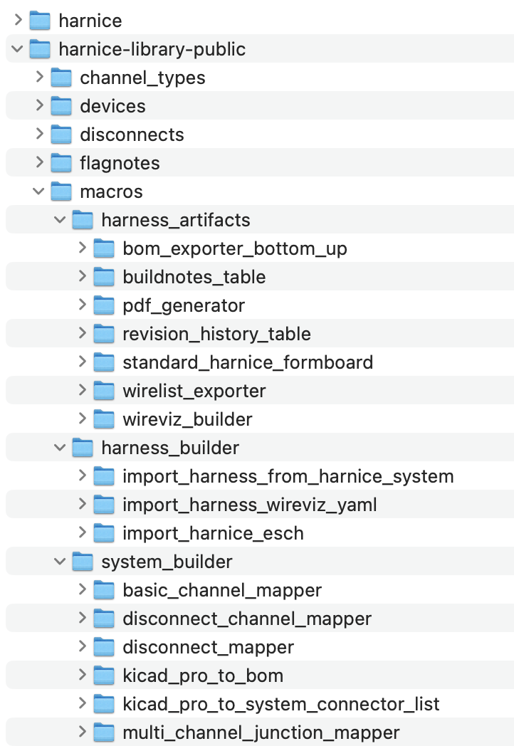
Macros
Macros I currently have written in the public library
A macro is a chunk of Python that has access to your project files or any other Python-capable function
When you call featuretree_utils.run_macro(), it will import the macro from a library and run it in your script
Some macros are designed to be used to build systems, build harnesses, or export contents “artifacts” from a harness instances list
Added to mkdocs

Slide 35
Build Macros
Intended to add or modify lines on an instances list based on a standard set of rules or instructions
Can read information from the instances list
Can read information from other support files
Examples
featuretree.runmacro(“import_wireviz_yaml”, “public”)
Reads a wireviz YAML (another commonly used harness design format)
featuretree. runmacro(“add_yellow_htshrk_to_plugs”, “kenyonshutt”)
You can write any rule or set of rules you want in Python, save it to your library, and call it from a harness feature tree.
This one, for example, might scour the instances list:
for plug in instances_list:
if item_type==plug:
instances_list.add(heatshrink, to cable near plug)
Added to mkdocs

Slide 36
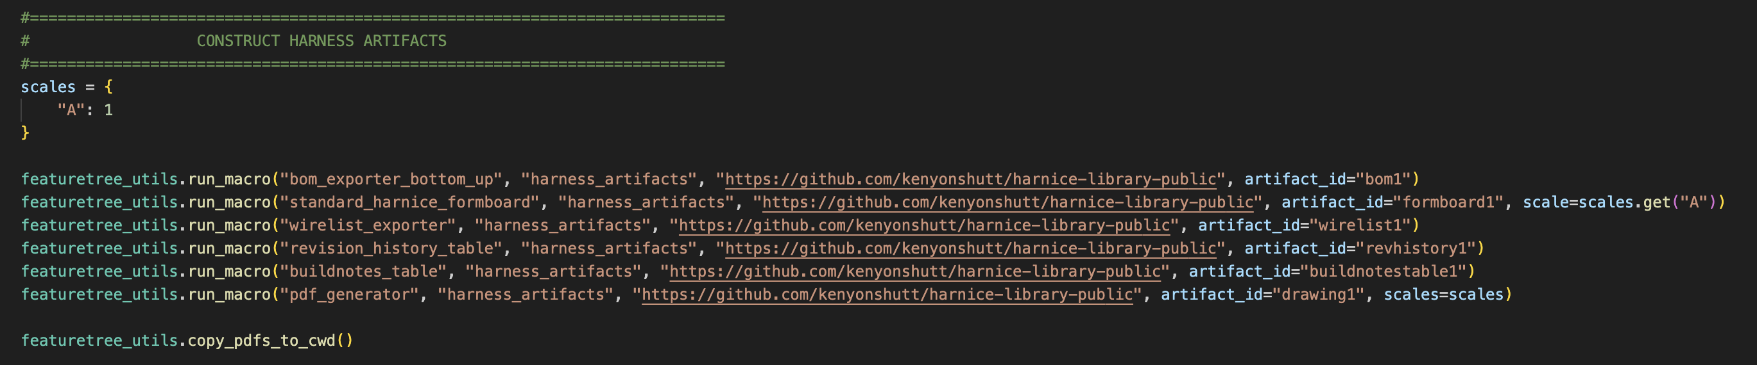
How to Generate Outputs
Output Macros will scour the Instances List or other artifact outputs and make other things out of it
BOM
Formboard arrangement
PDF drawing sheet
Analysis calcs
Write your own!
Added to mkdocs

Slide 37
PDF Generator
This is the notional flow of SVG content when you run the PDF generator macro.
Titleblocks in library repo
The graph on this page shows the relevant part of the file hierarchy of a harness project.
Harness rev folder
directory
instance_data
json
svg
Literally any file that ends in –master.svg
imported_instances
PDF
1. Import titleblock content into project
Titleblock
Macro
Update for new fileio structure, make less overhwelming
Project titleblock folders
{Macro that called it}-
{page number}-
{page name}
4. Go find all generated content
{Macro ID}
Library_used_do_not_edit
Page_svgs
Page_setup.json
Project titleblock files
direct_from_project_titleblock
Master contents svg
{macro id}-{page name}-attributes.json
5. Merge into user editable page svg
Output PDF
6. Combine into output PDF
{macro id}-{page name}-drawing.svg
{page_counter}-{page name}-user editable.svg
1.5 User can edit titleblocks directly here
2. Copy into macro directory
Macro-{macro ID}-{page name}
Macro titleblock files
5.5 User can configure page content and layout here by cloning master contents groups and placing the clones on the page
{macro id}-{page name}-attributes.json
5. Merge into user editable page svg
3. Text replacements automatically performed (adds page number, pn/rev, etc)
{macro id}-{page name}-drawing.svg
{macro id}-{page name}-drawing_with_text_replacements.svg

Slide 38
FILE STRUCTURE

Slide 39
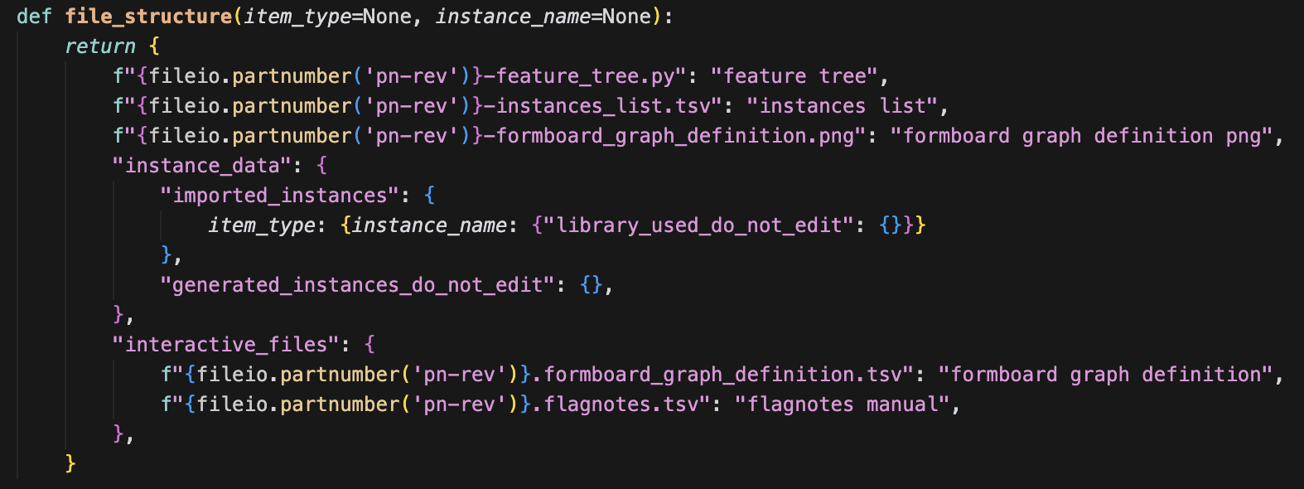
Centralized file structure
fileio.py contains functions that keep your files organized and easy to reference when they’re needed.
Products and macros are all supposed to have a function file_structure() that represents the file structure of the contents of that product on top of the current directory (rev folder).
Each value that contains a dict represents a directory, and each value that contains a string represents a file.
Added to mkdocs
Keys are used for files to be more human readable.
You can add args as needed to describe more complicated structures.

Slide 40
How to query file structures
When a product is rendered, that product’s file structure is automatically loaded into fileio.
You can reference files in that product by calling fileio.path(“file key”) from your script.
You can reference directories in that product by calling fileio.dirpath(“dirname”) from your script.
If you want to reference files that might not be defined in your product’s file structure (you’re running a bespoke macro with some weird content), you can temporarily pass a filepath dictionary into the function: fileio.path(“file key”, structure_dict={})
The same fileio functions can be called to regard different results depending on what structure_dict your current product, project, macro, etc has defined.
Added to mkdocs

Slide 41
Fileio python commands
Command | Args | Returns | Purpose
fileio.set_file_structure() | File structure dict |  | Set the default fileio.path() and fileio.dirpath() lookups. Call at the beginning of each product render
fileio.file_structure() |  | File structure dict | You shouldn’t need this, use path() or dirpath() instead
fileio.part_directory() |  | Directory of the part you’re working in | Anything
fileio.rev_directory() |  | Directory of the rev of the part you’re working in | Anything
fileio.partnumber() | Wanted format # given a part number "pppppp-revR" # "pn-rev" returns "pppppp-revR" # "pn" returns "pppppp" # "rev" returns "revR" # "R" returns "R" | Part number, rev strings of the current product you’re working on in various formats | Anything
fileio.silentremove() | Filepath |  | Remove a file or a directory and all its contents if it exists
fileio.path() | Filename key Optional: alternative file structure dict | Path to the file referenced by key | Any time a file needs to be referenced directly
fileio.dirpath() | Name of directory Optional: alternative file structure dict | Path to the folder referenced by key | Any time a directory needs to be referenced directly
fileio.verify_revision_structure() |  |  | Ensures you’re working in a directory recognized as a “rev” directory (must be inside a “part” directory)
fileio.today() |  | today’s date in a common format
fileio.get_path_to_project() | traceable_key | Looks up traceable key in a local git-ignored lookup table for the local path to a project | Referencing projects that’s not the current project (ex. pulling harness data out of a system)
fileio.read_tsv() | path to file, optional delimeter (default \t for tab-separated-values) | data of a csv with delimeter as a list of dictionaries | Standardize the way we’re reading TSV’s. TSV’s are preferred to CSV’s because they let you use commas in your data which is useful
fileio.newrev() |  |  | Works with the CLI to make a new revision file in the part directory. Updates the names of all the content from old rev number to new rev number

Slide 42
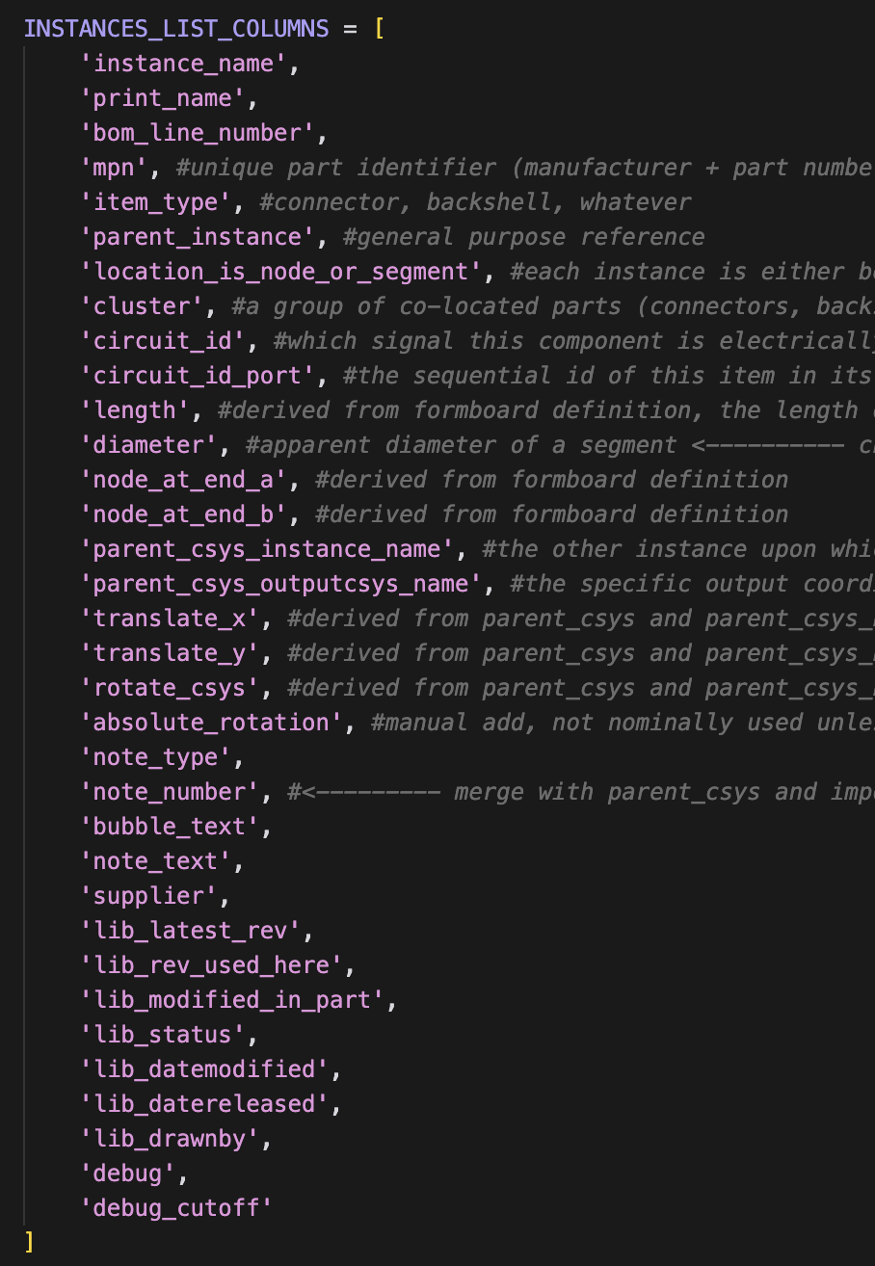
Data structure: “instances_list.tsv”
A list of every single item, idea, note, part, instruction, circuit, literally anything that comprehensively describes how to build that harness or system
TSV (tab-separated-values, big spreadsheet)
Declined alternatives: STEP files, schematics, dictionaries not general, descriptive, or human readable enough
Added to mkdocs

Slide 43
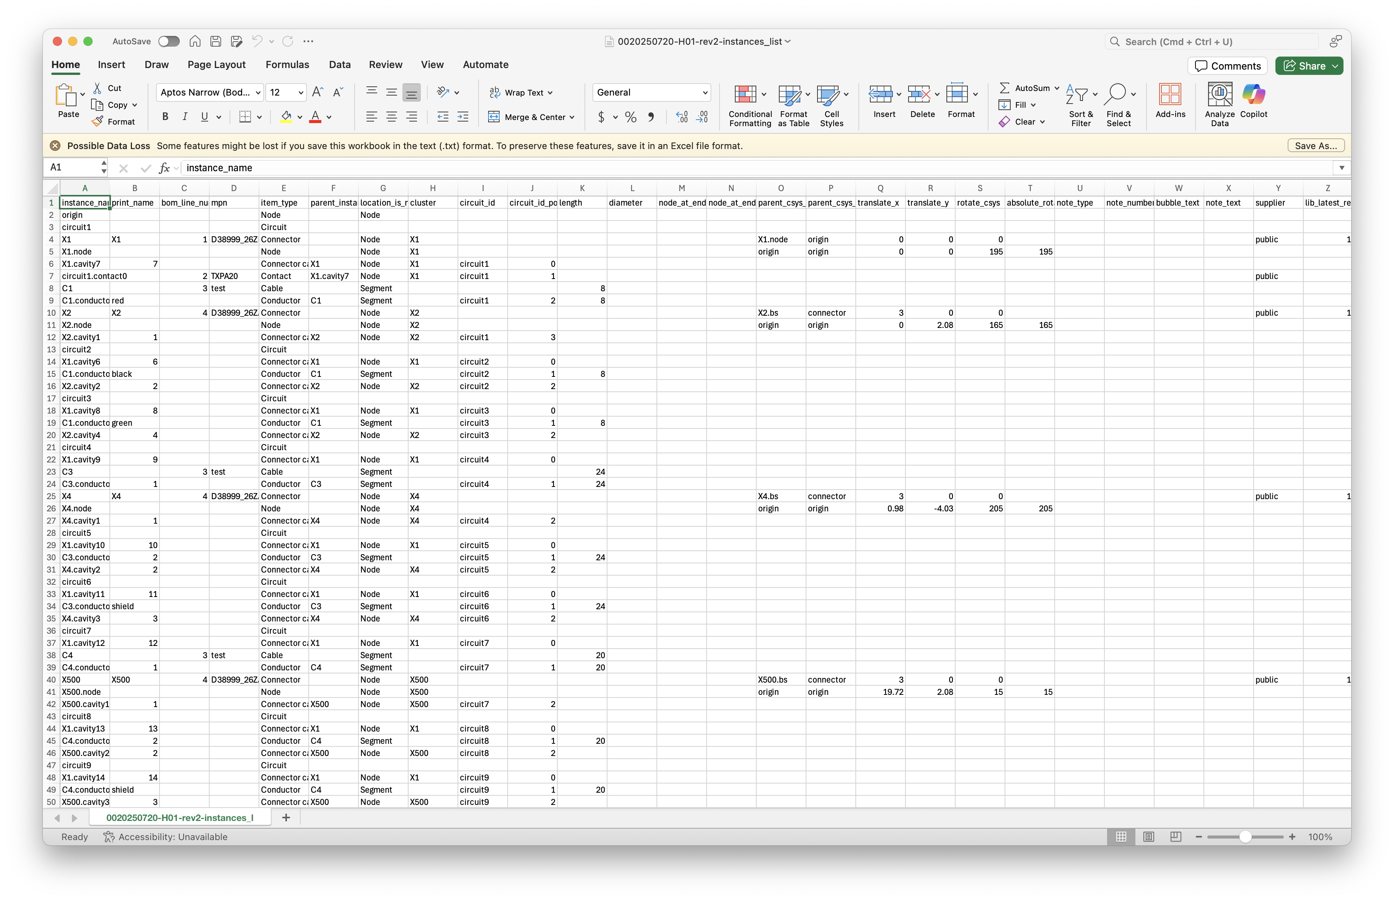
Harness Instances List example

Slide 44
Local Paths vs Traceable URLs
Added to mkdocs

Slide 45
Harnice Code Repo Structure
Functions that interact directly with project files (tsv, csv, …)
Use for writing your own lower level scripts and macros
Harnice
Lists
Products
Utils
cli.py
fileio.py
Mostly <product>.render() with some exceptions
High level functions
Handles command line interface
Handles file structure

Slide 46
Libraries
Parts, macros, titleblocks, flagnotes, etc, should be re-used and referenced for any future use
Users are heavily encouraged to contribute to the public git repo for your cots parts
harnice-library-public
However, you can define paths to as many library repos as you want.
my-company-harnice-library
my-super-top-secret-harnice-library
You don’t even have to use git to control it if you don’t want!
Added to mkdocs

Slide 47
REVISION CONTROL

Slide 48
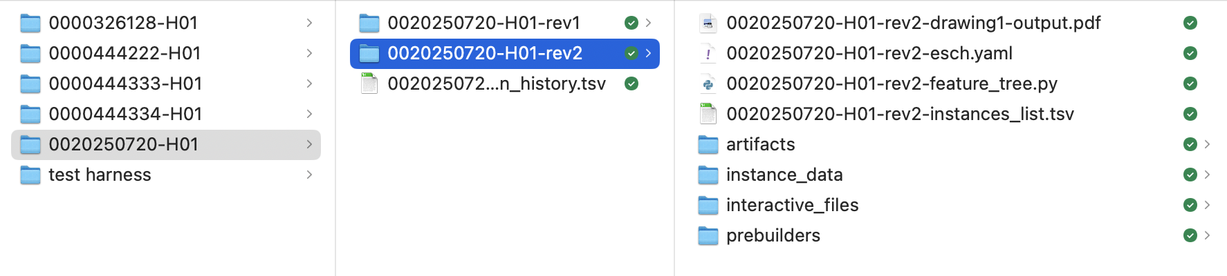
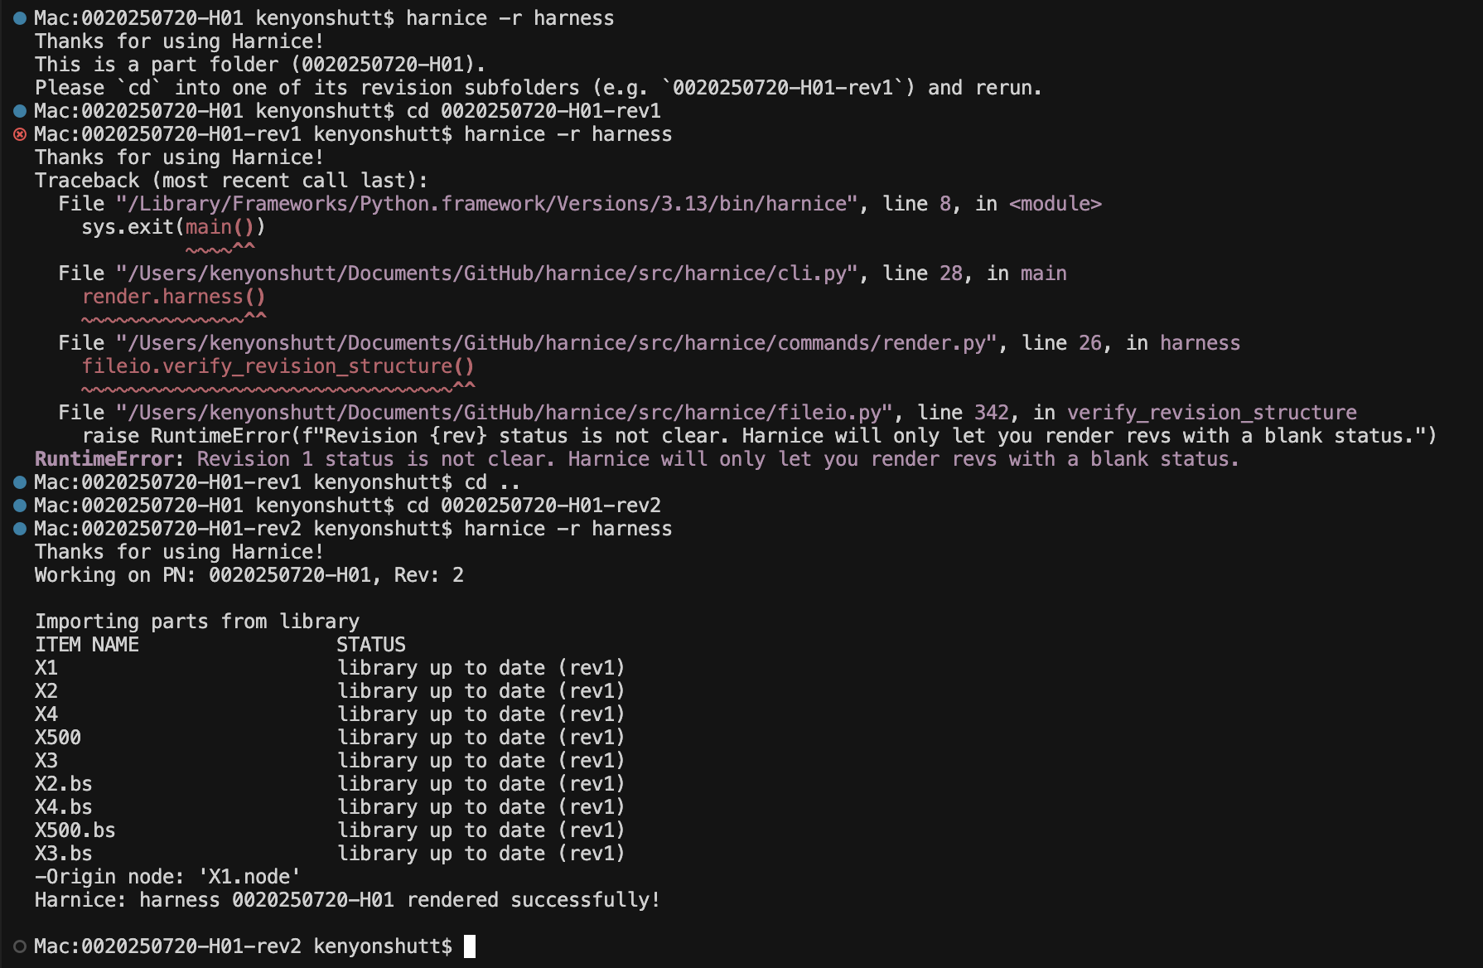
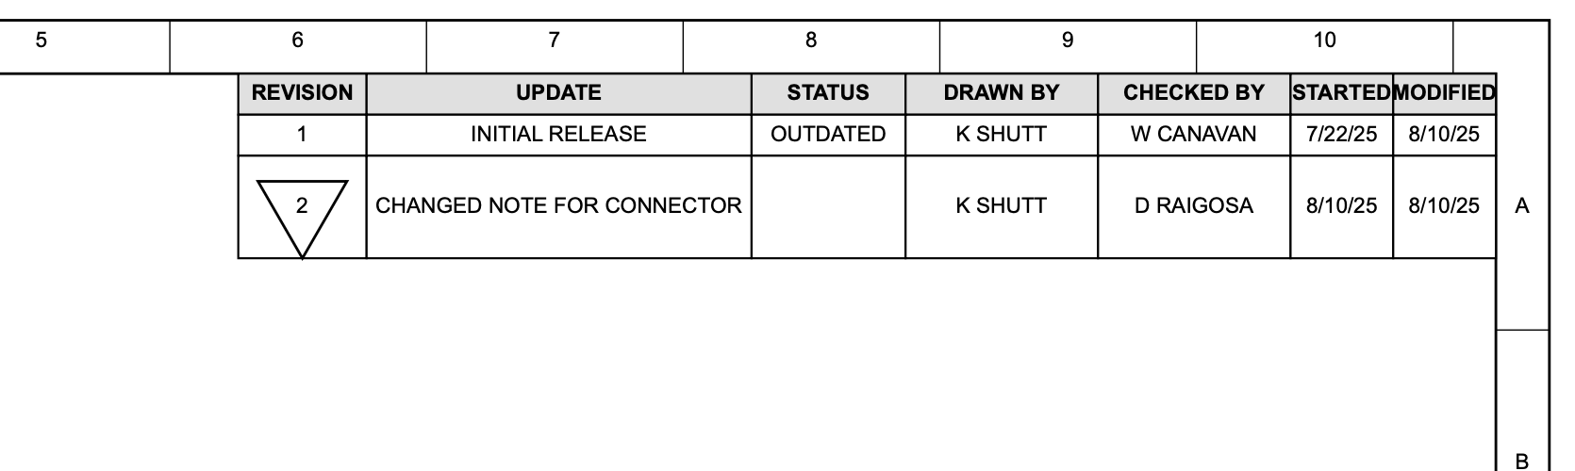
Product version control
To “render” a product (harness, part, etc) with Harnice, the CLI will force you to operate in a “rev folder”
Revision data always stored in revision_history.tsv
Harnice will not render a revision if there’s data in the “status” field, i.e. “released” or “outdated”
Revision information can be referenced elsewhere, ex in pdf_generator
Added to mkdocs

Slide 49
LIBRARIES

Slide 50
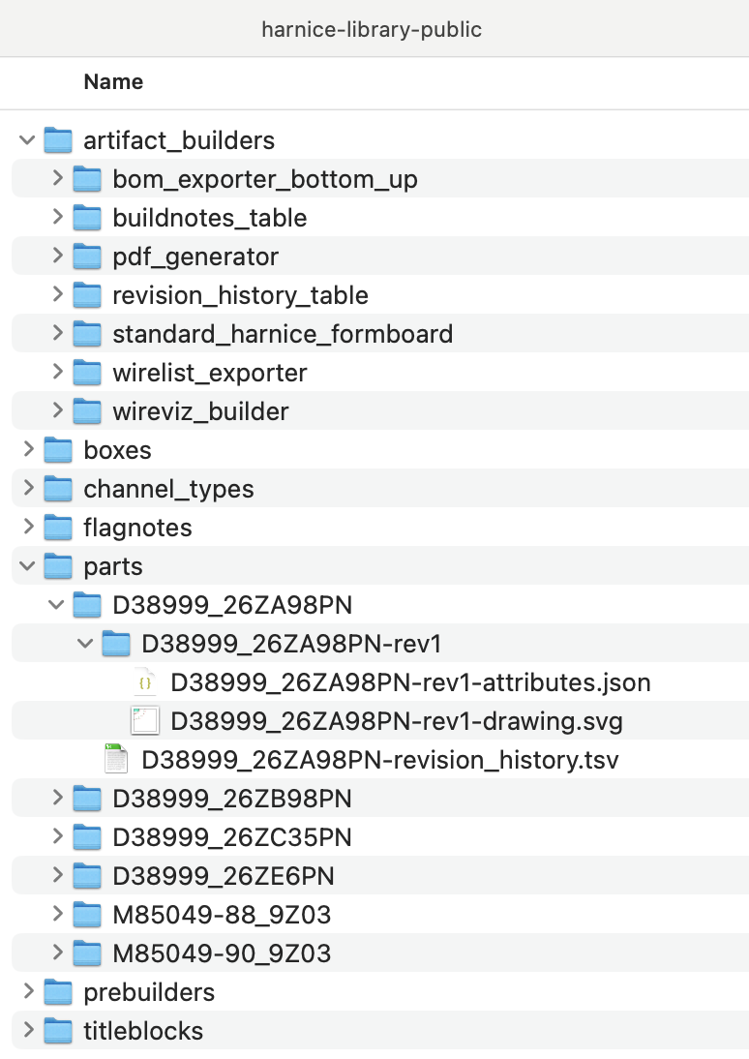
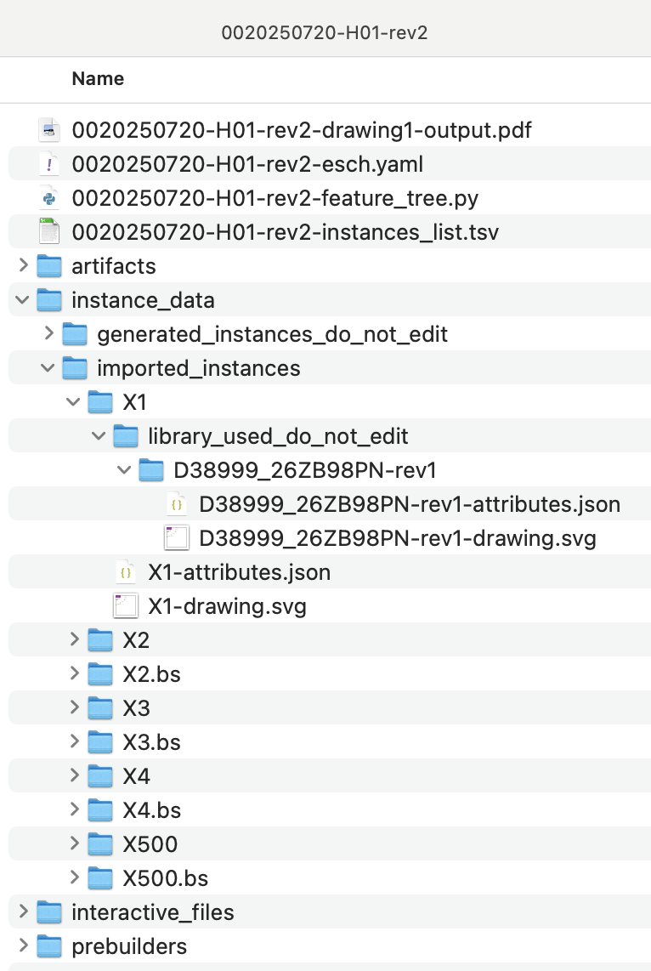
Library flexibility
All parts in a library are version controlled per previous slide…
When importing an item from library, you can request different versions or overwrite imported libraries flexibly…
Library will be imported new at every Render for traceability purposes
User-editable copy (instances_list tracks “modified” from imported library)
revision_history.tsv to track all revisions of a product
Different instances, even with the same MPN, are imported separately
All imported items work the same way

Slide 51
EXAMPLES

Slide 52
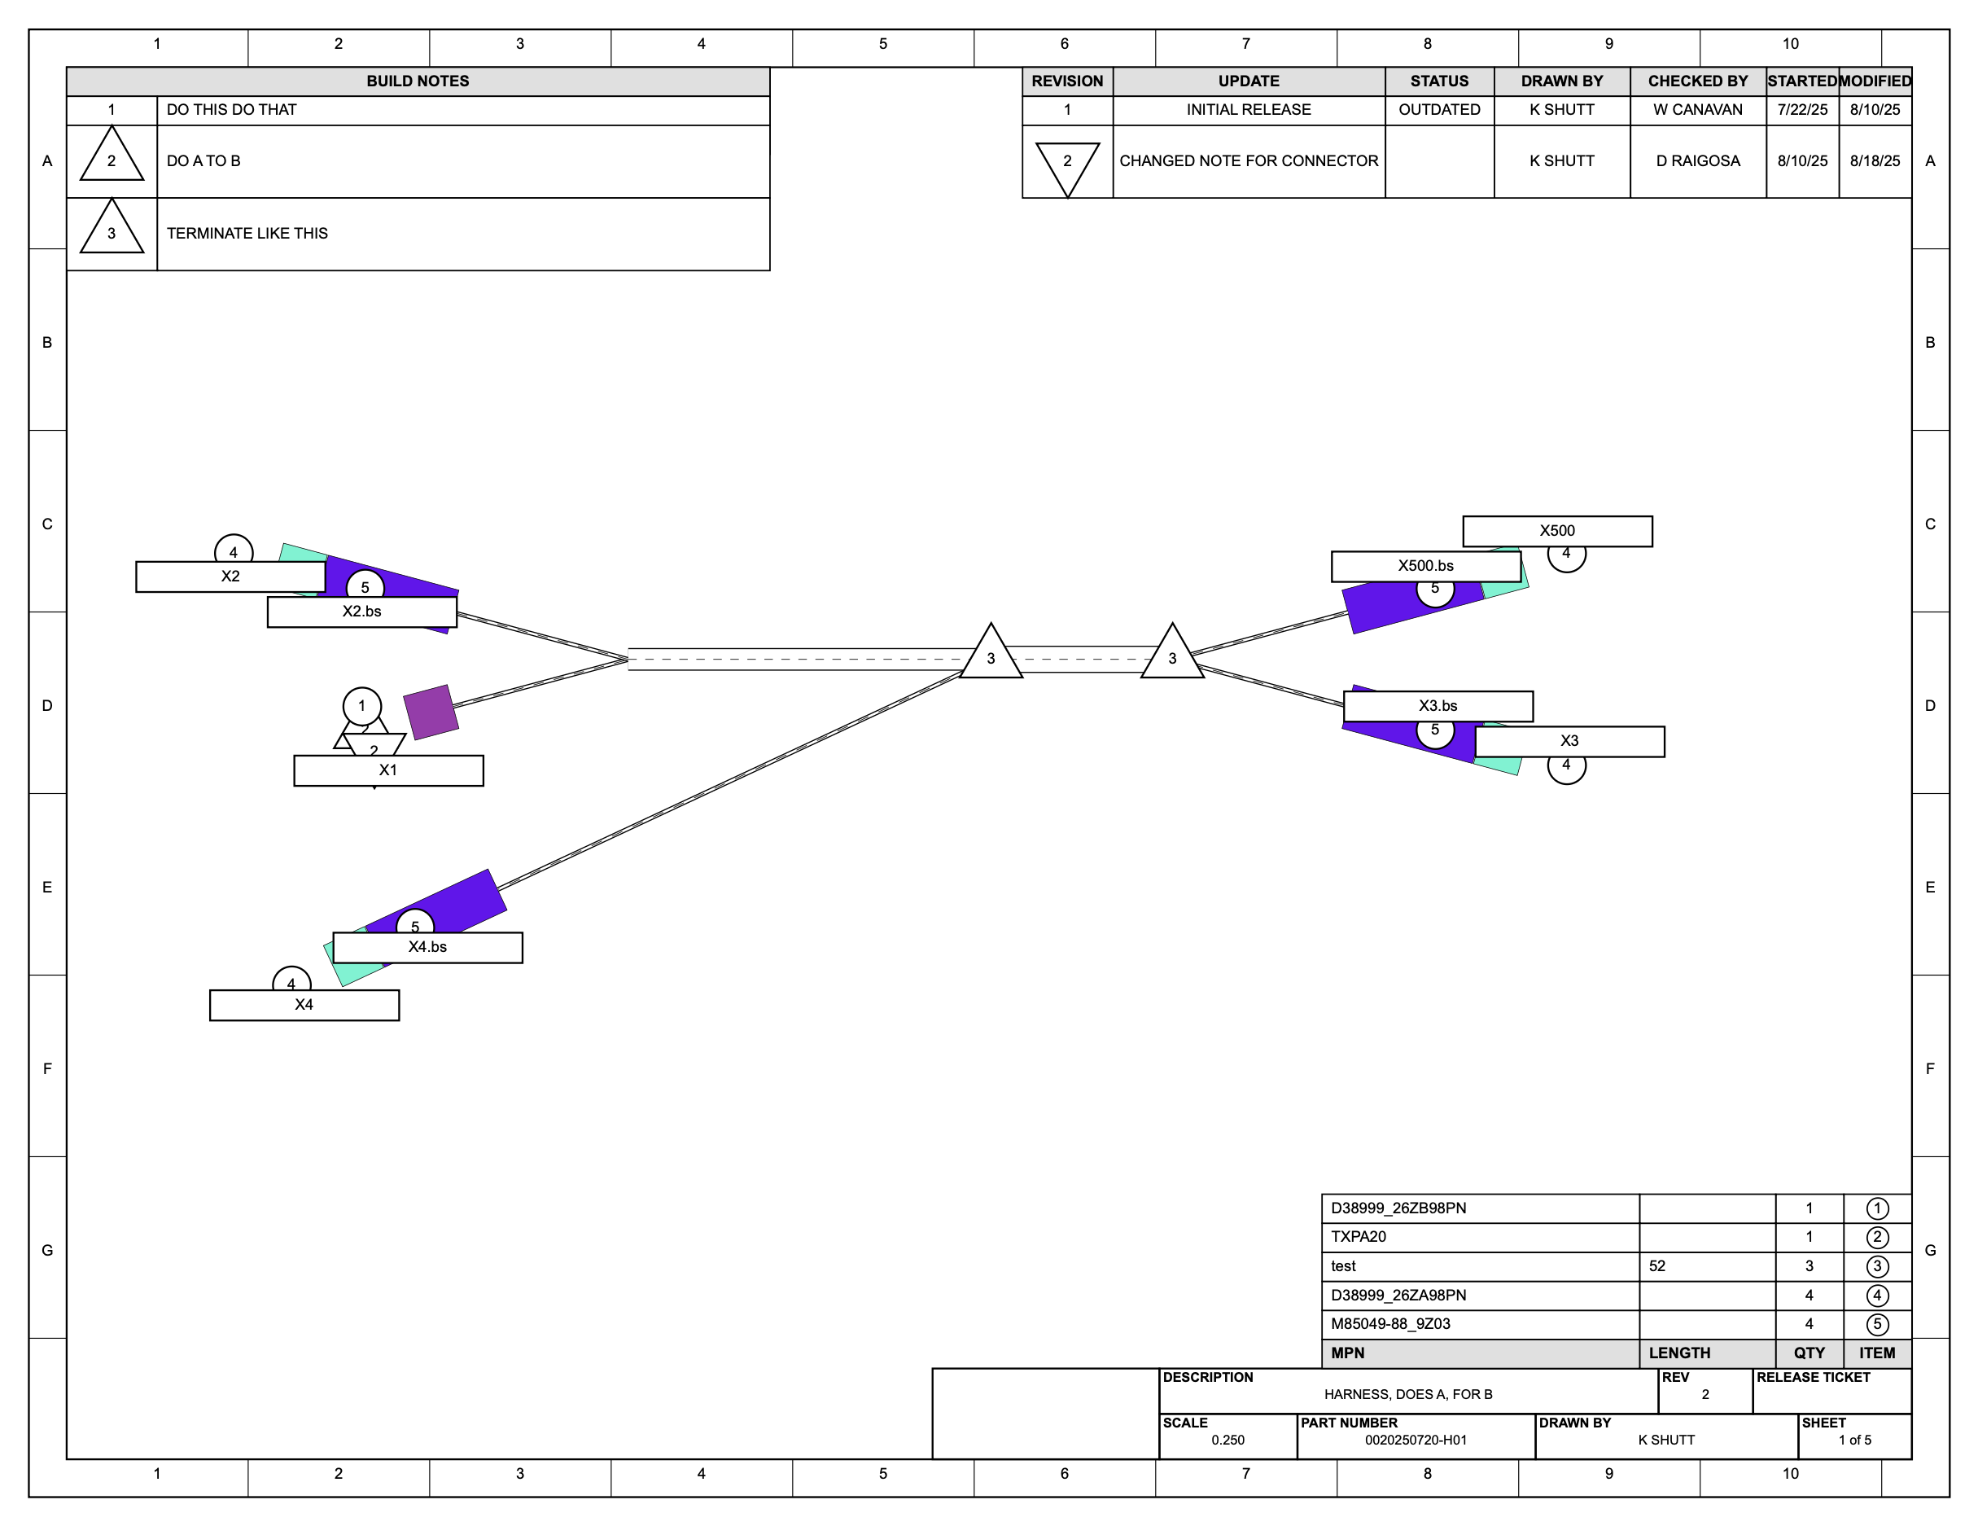
Show me what you can do!
Here’s an output from a macro called “pdf_generator”.
It compiled the outputs of other output macros like “harnice standard formboard builder”, “bom to svg”, “buildnotes to svg”
It knows the scale, the location, the buildnotes you need, what your parts look like, the revision history, all from the information on the Instances List

Slide 53
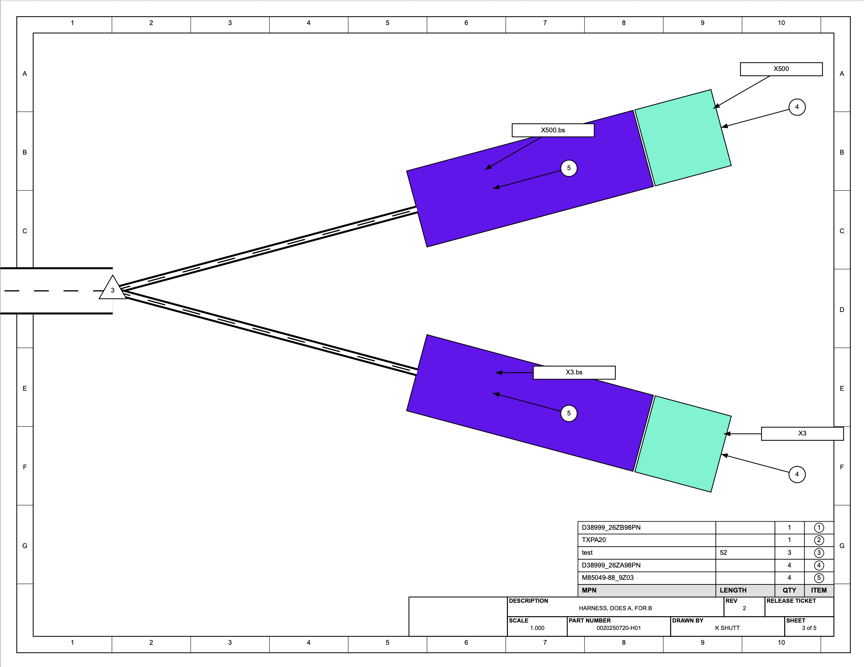
Another page shows a 1:1 scale view on a 8.5”x11” sheet.
Connectors and backshells shown here are just rectangles, but could easily be photos or CAD screenshots.
Flagnote positions are not well-defined, but can be configured as needed.

Slide 54
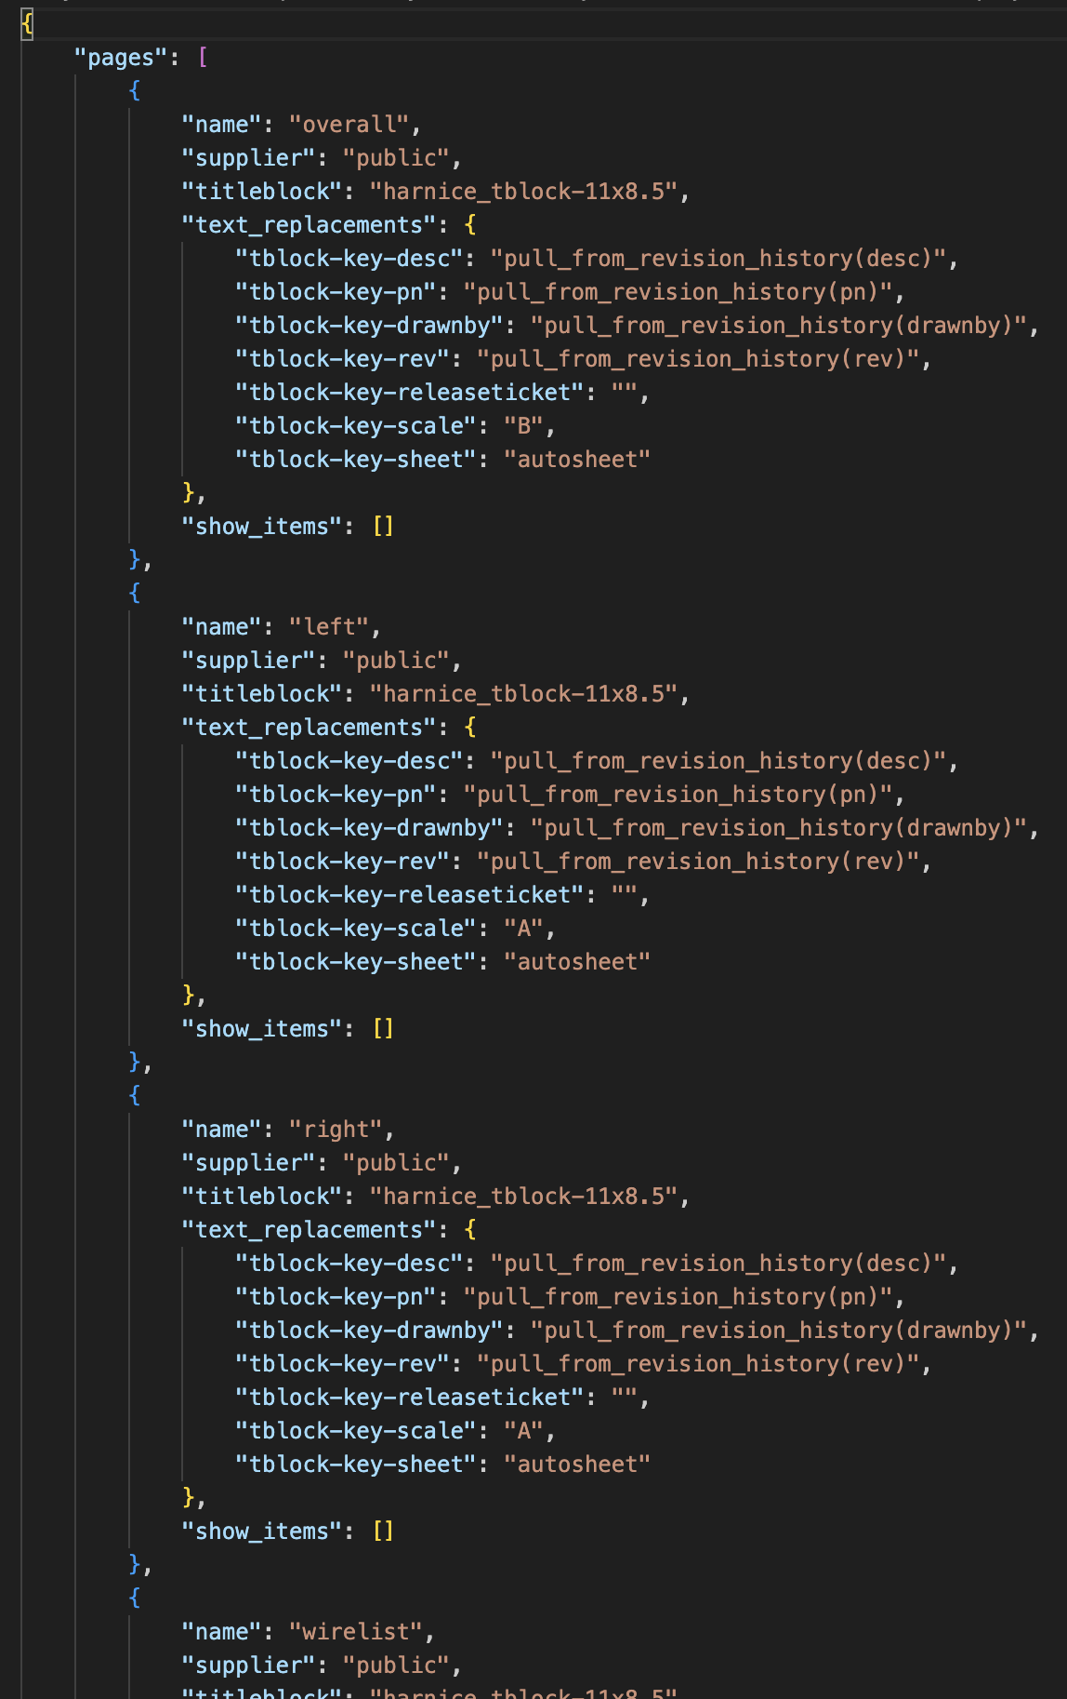
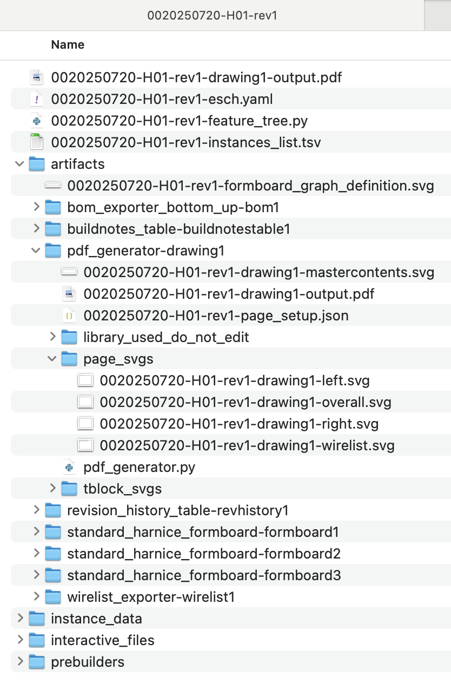
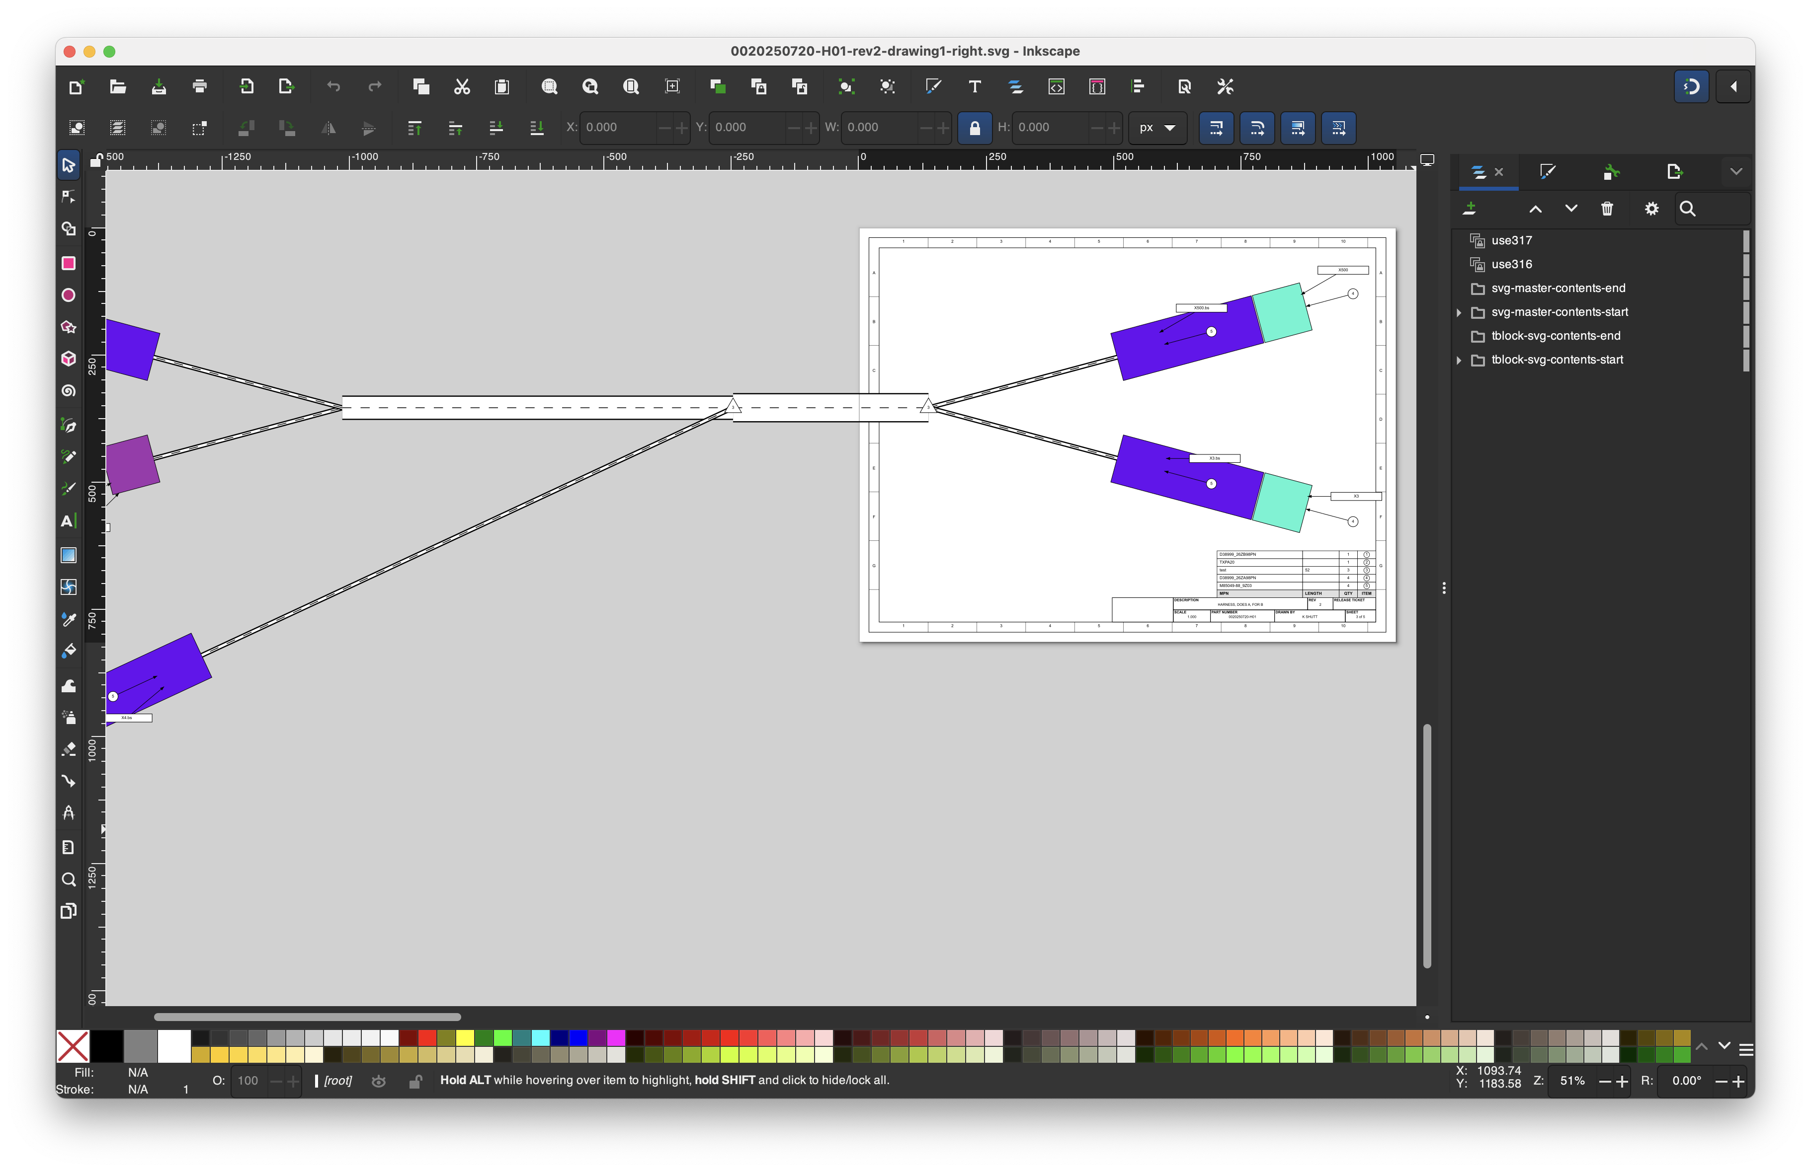
Pages can be edited with your favorite SVG editor…

Slide 55
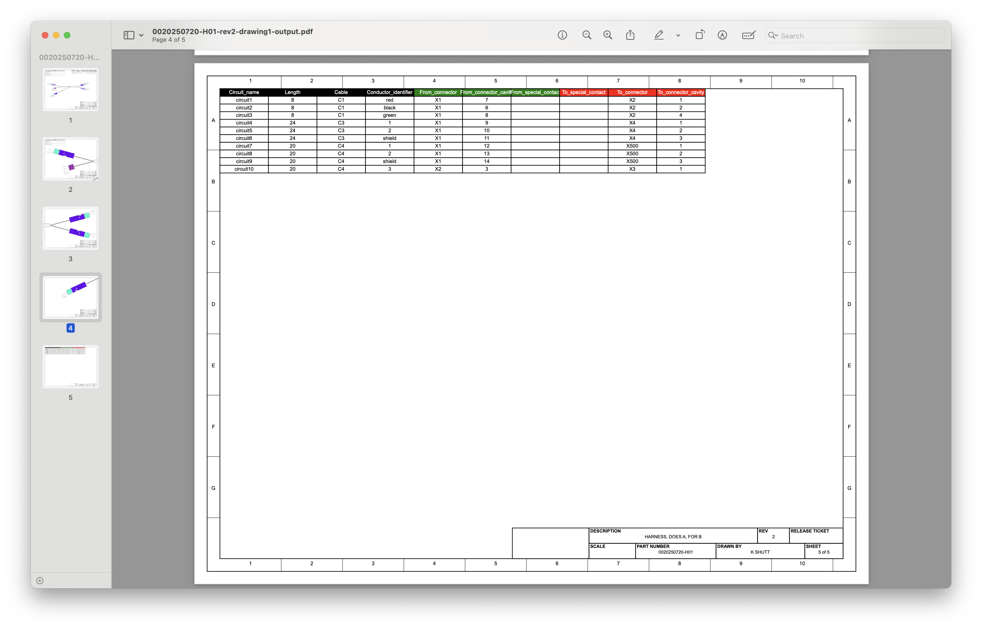
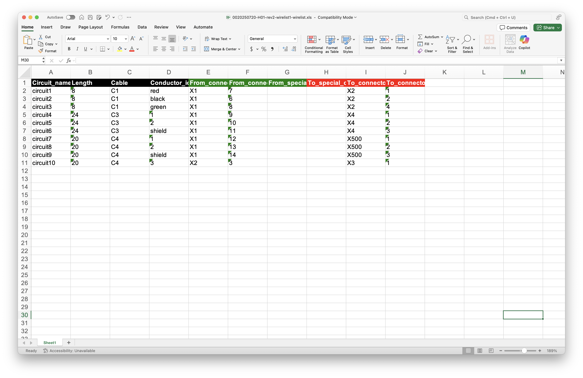
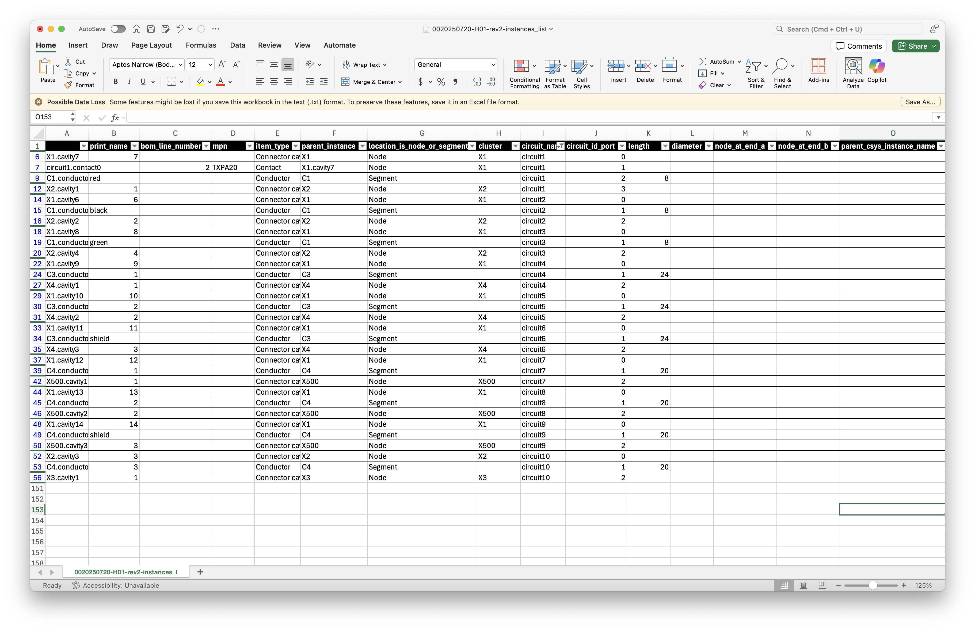
Of course…
All output artifacts are perfectly in sync with the Instances List

Slide 56
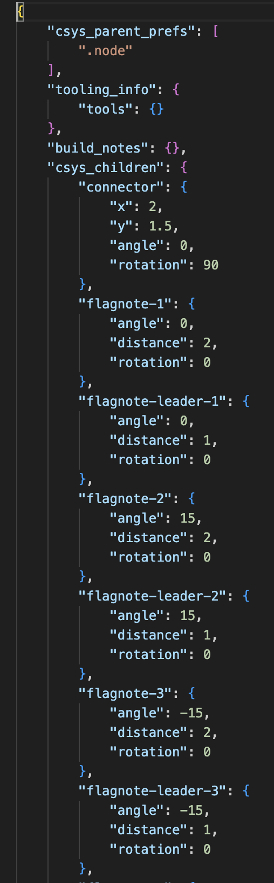
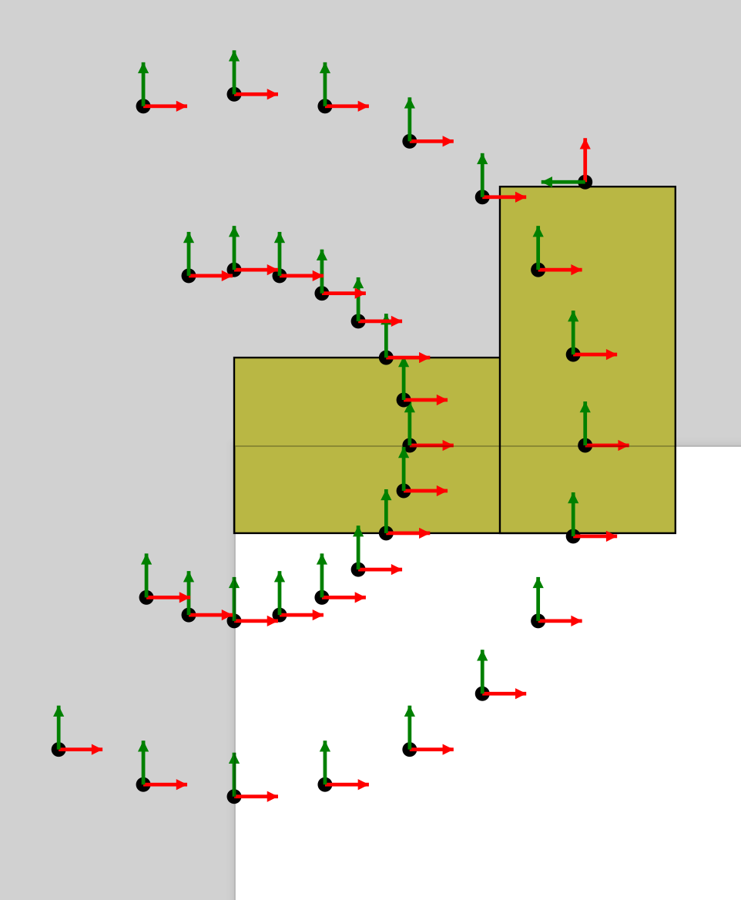
Every part can have as many child coordinate systems as you need
These can be referenced in the instances list
Used for things like flagnotes, child parts, or other related items
Can be used to place parts on a formboard drawing, calculate distances, etc

Slide 57
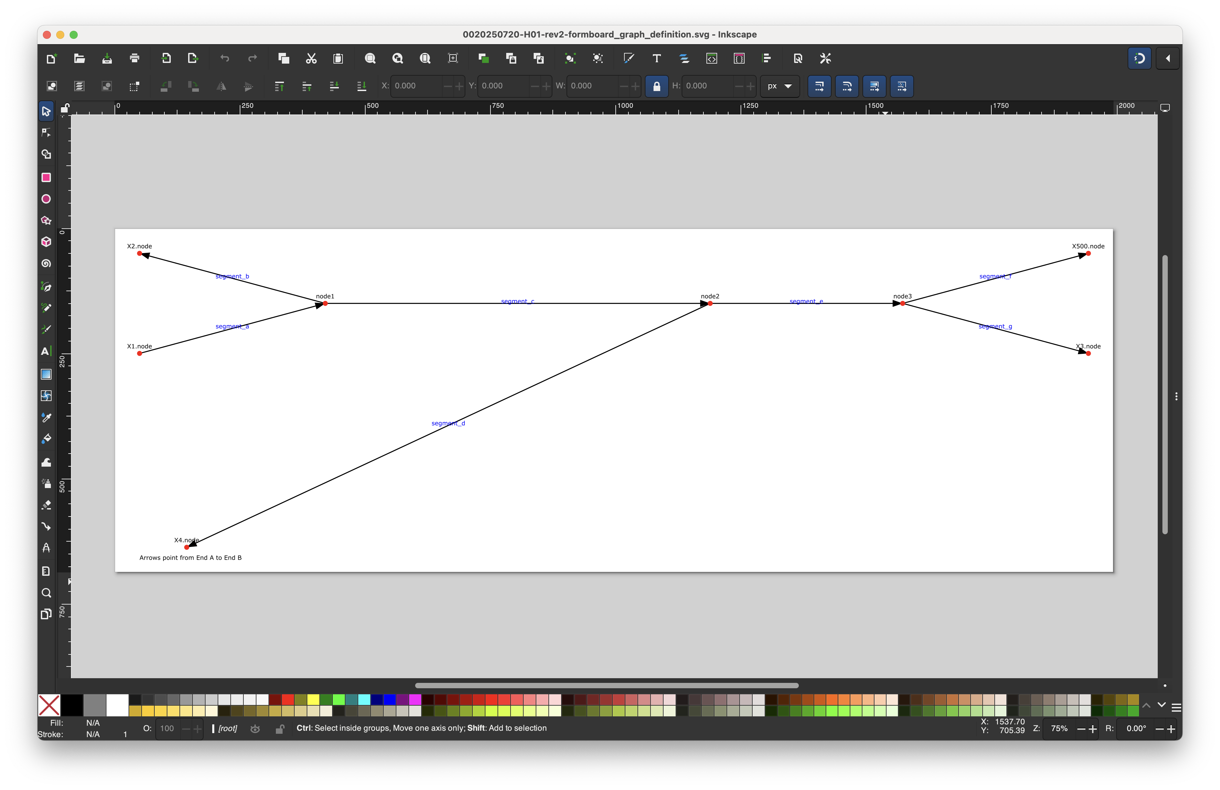
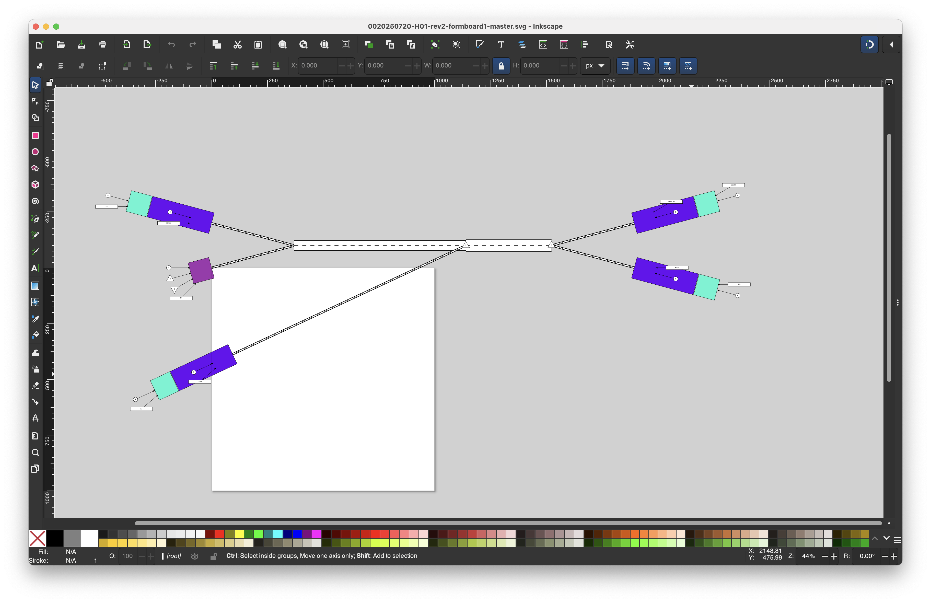
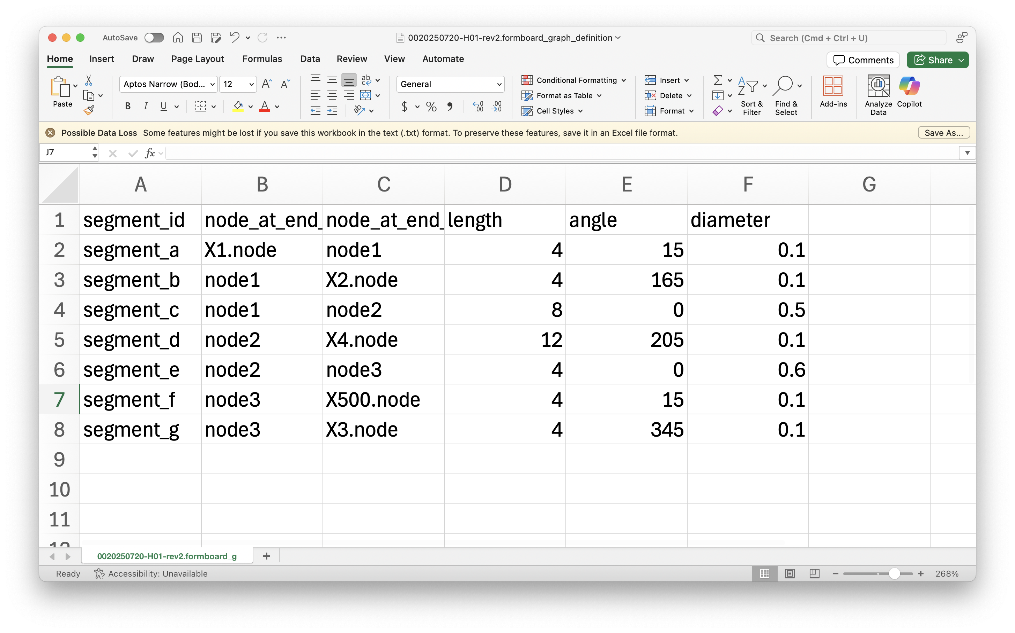
Defining a physical layout
For now, formboard_definition.tsv allows user to input length and angle preferences
These sync with cables and requirements from instances_list
Eventually, I’ll make a GUI

